Slide 1
R summary results vs1

Slide 2
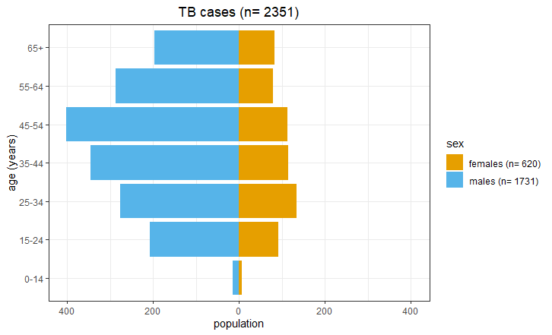
Figure 1

Slide 3
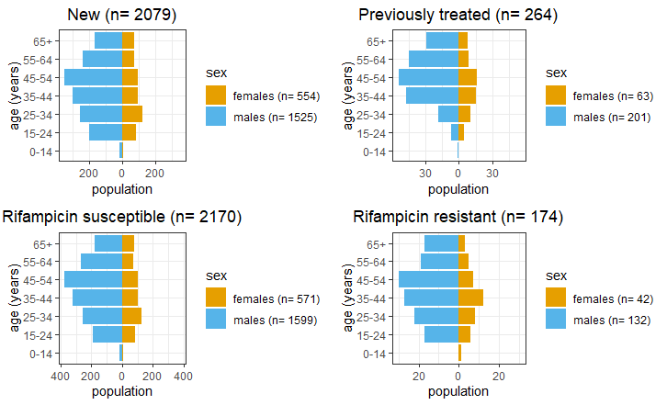
Figure 2

Slide 4
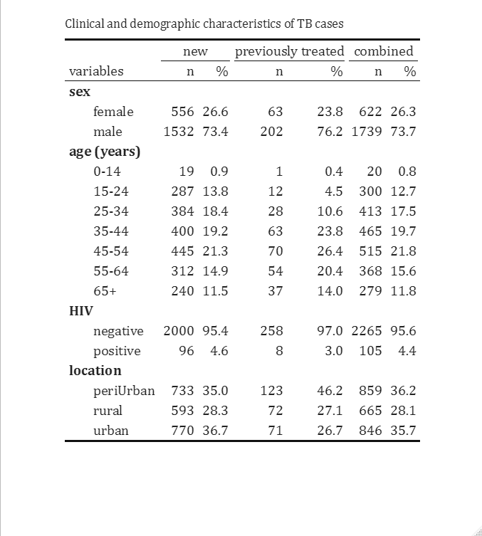
Table 1

Slide 5
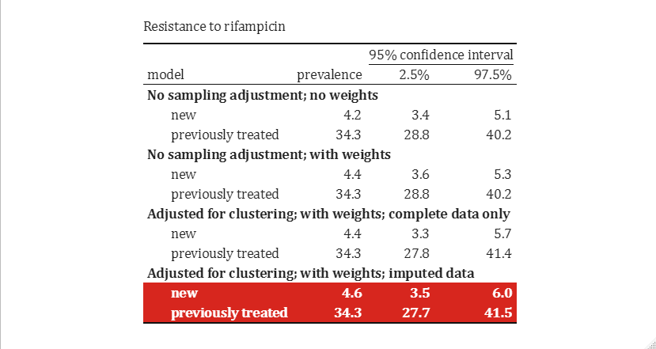
Table 2

Slide 6
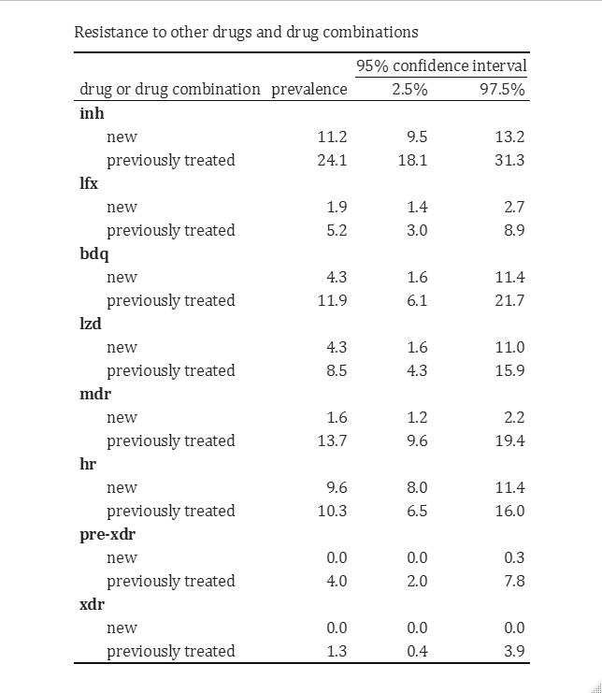
Table 3

Slide 7
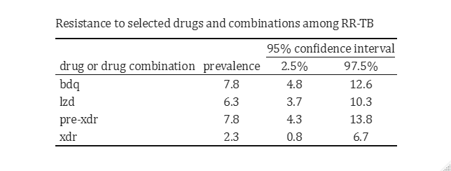
Table 4

Slide 8
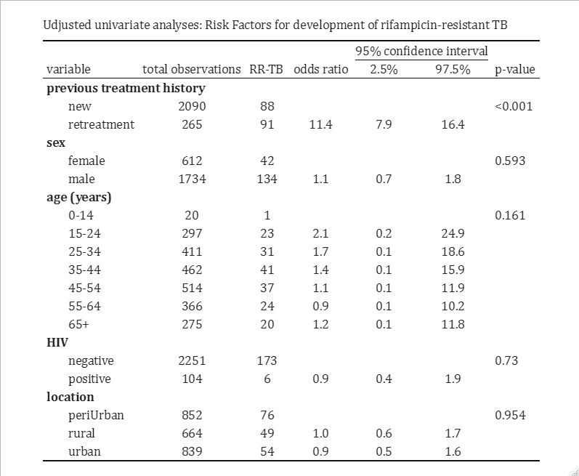
Table 5

Slide 9
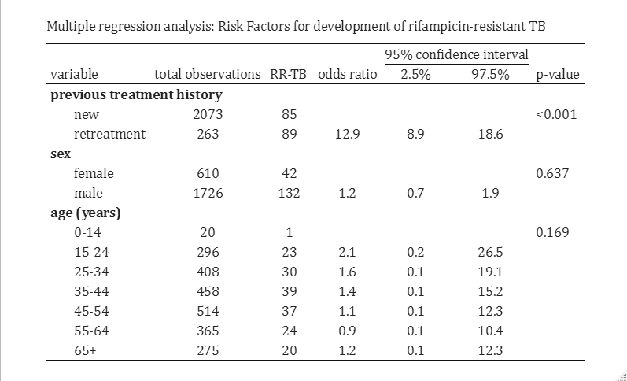
Table 6

Slide 10
Cluster size visualisation in R vs1

Slide 11
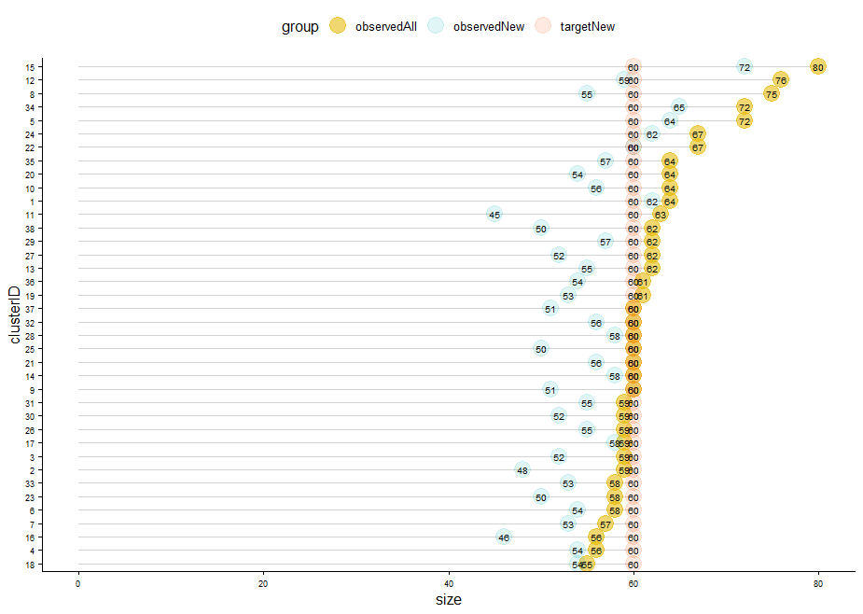
Cluster size example visualisation

